Slide 1

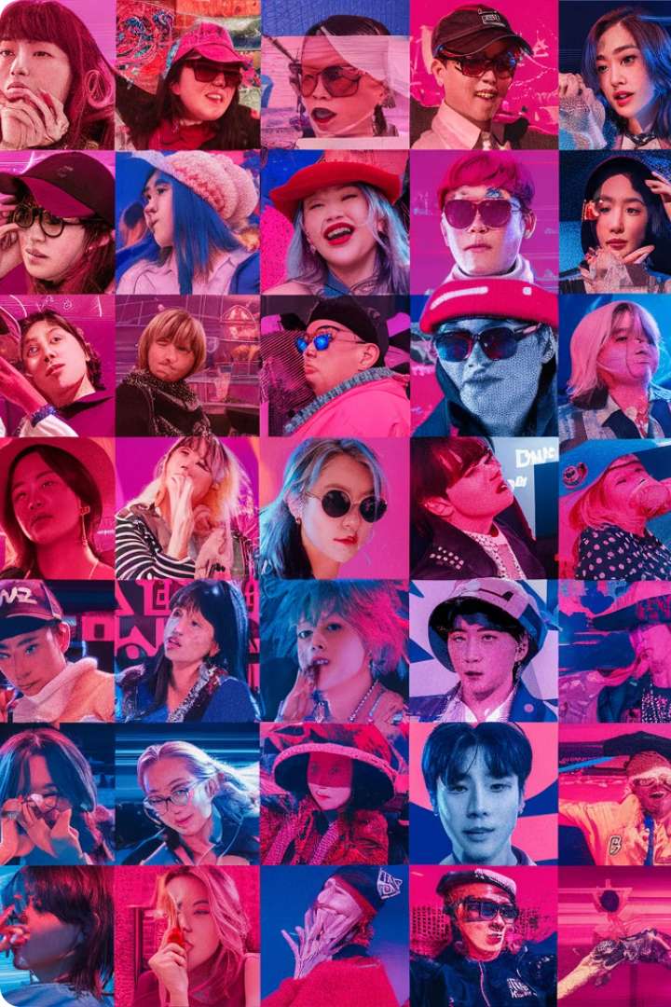
The Globalizing K-Pop Project: Sentiment Analysis of Global Fandoms on Social Media
This research delves into the world of global K-Pop fandoms, seeking to understand the sentiment expressed by fans on social media platforms. By analyzing online discussions, we aim to identify the emotions, opinions, and support networks within these communities, shedding light on the cultural impact of K-Pop and its role in fostering global interconnectedness.
Prepared by:
Aditi, Gunpreet, Krish

Slide 2

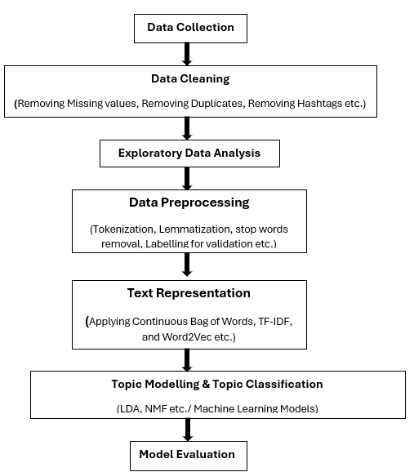
K-pop Project- Research Workflow
Data Source
1
This project utilizes Reddit as the primary data source.
2
Web Scraping
Data Cleaning
3
4
Natural Language Processing (NLP)
NLP techniques are applied to prepare the data for sentiment analysis. This involves language processing, stemming, or lemmatization, depending on the language of the comments, to standardize the textual data and extract meaningful insights.
Topic Modelling and Topic Classification
5

Slide 3
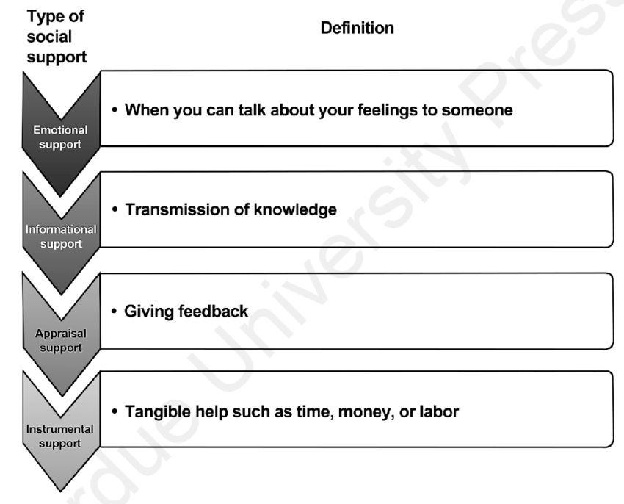
Data Collection
Subreddit Selection
Smaller fandoms for more fan interaction
Subreddits Used: SF9, EXO, Red Velvet, Twice, Super Junior
Data Collection:
Using PRAW for data collection
Filtered and Unfiltered data for all subreddits
Filtering:
Filtered using the keyword list from last year
Manual Labeling:
Chose SF9 for manual labeling
Categories: Emotional, Informational, Appraisal, Instrumental

Slide 4
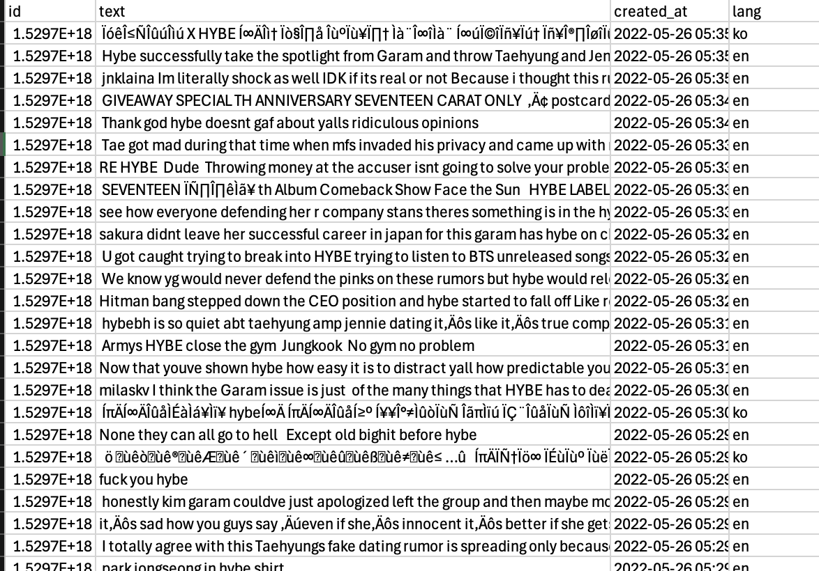
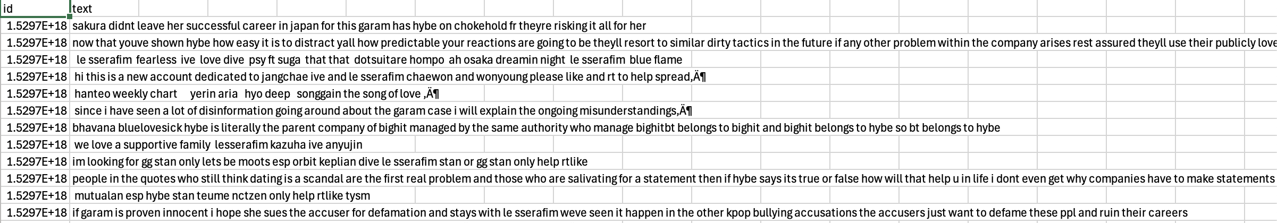
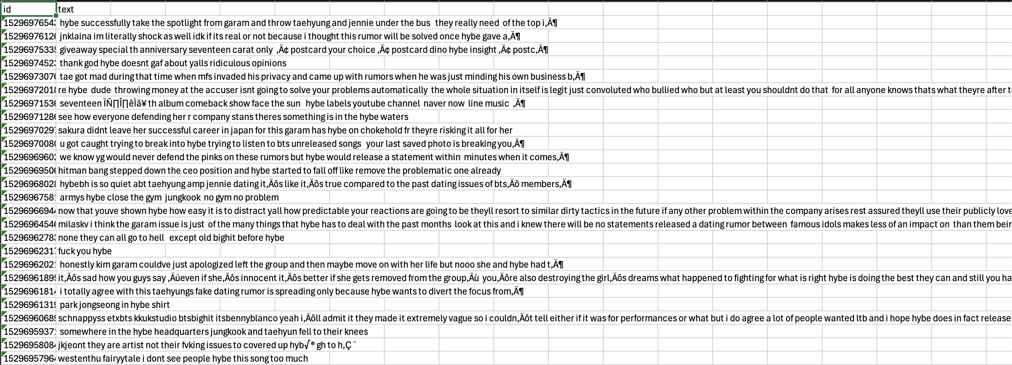
New Data Collection
Unfiltered
Keyword Filtered Data
English Filtered

Slide 5
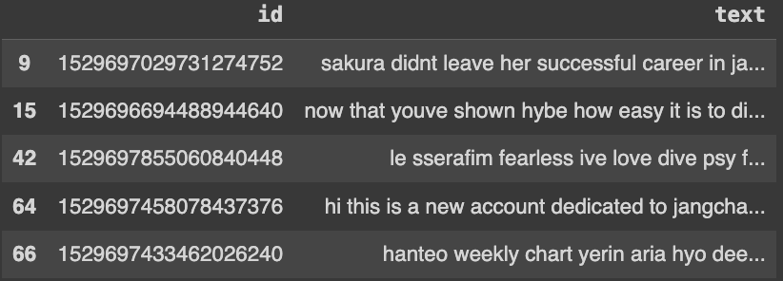
Data Pre-Processing
Removing Special characters(like *,^ etc.)
Lowering case
Remove Stopwords
Tokenization(Convert sentences to tokens or words)
Lemmatization( Convert word to root form and compare with vocabulary)

Slide 6
Text Representation: Mapping Words to Meaningful Vectors
TF-IDF
voyage-large-2-instruct
The Term Frequency-Inverse Document Frequency (TF-IDF) technique is used to calculate the importance of words within the dataset. This weighting scheme considers the frequency of words in each comment and their overall presence across the entire dataset. Words that appear frequently in a particular comment but are relatively rare across the corpus are deemed more significant.
Instruction-tuned general-purpose embedding model optimized for clustering, classification, and retrieval.

Slide 7
Topic Modelling: Unsupervised Learning
Steps for Topic Modelling
Data Preparation: Load and preprocess the text data.
Text Vectorization: Convert text data into numerical form using TF-IDF and voyage-large-2-instruct
Model Training: Train using Models like LDA, NMF, LSA and BERTopic
4. Visualization of Clusters: Using PyLDAvis, Word Cloud and Coherence Score
6. Top Keywords Extraction: Extract and visualize top keywords for each topic.

Slide 8
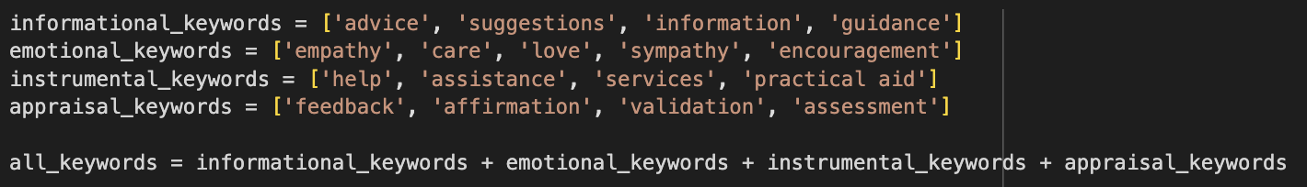
Keywords

Slide 9
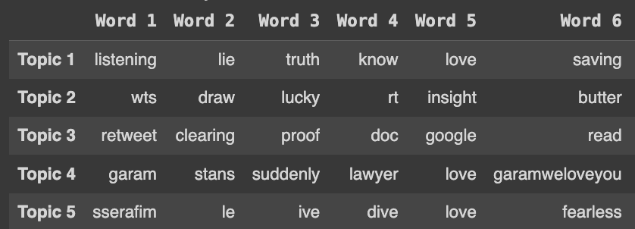
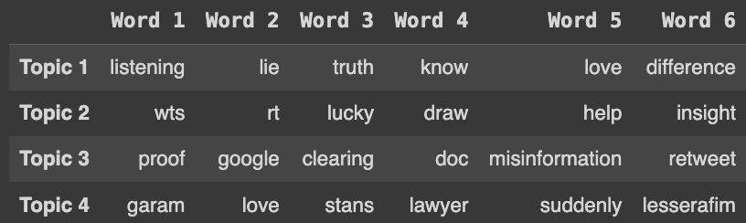
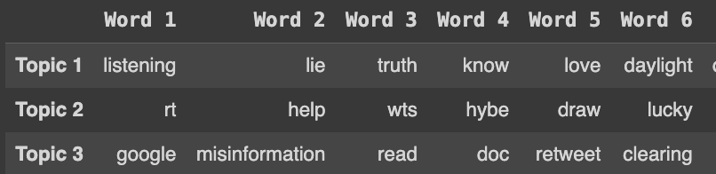
Results of Model Training
NMF(Negative Matri Factorization)
N=5
N=4
Top Words
Top Words
Coherence Score: 0.4855861714133499
Coherence Score: 0.4714147632094634
N=3
Top Words
Coherence Score: 0.3814318329707434

Slide 10
Analysis of Keywords for understanding(NMF)
Case 1: When Topics = 5:
Topic 1: Personal and Emotional Themes
Top Words : listening, lie, truth, know, love, saving, daylight, difference, time, isnt, kazuha, jimin, dont, taehyung, people
Types of Support:
Emotional Support: 'love', 'saving', 'daylight', 'difference' (expressing emotions and personal experiences).
Informational Support: 'know', 'truth' (seeking or sharing knowledge and truths).
Appraisal Support: 'listening', 'lie' (evaluating situations or personal experiences).
Topic 2: Trading and Promotional Activities
Top Words : wts("Want to Sell,"), draw, lucky, rt(retweet), insight, butter, help, pc(“Price check”), hybe, btsmarketmy, btstradingmy, postage, pasarbts, including, wm(Warner Music -music company).
Types of Support:
Instrumental Support: 'wts' (want to sell), 'draw', 'help', 'pc', 'postage' (facilitating transactions and logistics).
Informational Support: 'insight', 'butter' (possibly strategies or discussions related to promotions).
Topic 3: Information Dissemination and Validation
Top Words : retweet, clearing, proof, doc, google, read, misinformation, outreach, hashtags, dating, idol, company, hybe, make, scandal
Types of Support:
Informational Support: 'proof', 'google', 'read', 'misinformation' (verifying information, spreading knowledge).
Emotional Support: 'scandal', 'outreach', 'hashtags' (discussing and responding to controversies).
Topic 4: Support and Admiration
Top Words : garam, stans, suddenly, lawyer, love, garamweloveyou, care, hybe, lesserafim, people, elainevkook, ba (supposed soul of a person or god), dont, bad, just
Types of Support:
Emotional Support: 'love', 'garamweloveyou', 'care' (expressing affection and support).
Appraisal Support: 'stans', 'bad', 'just' (evaluating situations or behaviours).
Instrumental Support: 'lawyer', 'dont' (possibly legal or practical assistance).
Topic 5: Music and Fandom Appreciation
Top Words : sserafim, le, ive, dive, love, fearless, lesserafim, group, girl, unnatural, wjsn, convomf, kazuha, song, help
Types of Support:
Emotional Support: 'love', 'fearless', 'help' (supporting artists and their work).
Informational Support: 'sserafim', 'lesserafim', 'group', 'wjsn', 'song' (discussing music and artists).
Appraisal Support: 'unnatural', 'convomf', 'kazuha' (evaluating artistic expressions or interactions)

Slide 11
Case 2: When Topics = 4:
Analysis of Keywords for understanding(NMF)
Topic 3: Information Dissemination and Validation
Top Words : proof, google, clearing, doc, misinformation, retweet, read, hashtags, outreach, dating, care, dont, hybe, idol, company
Types of Support:
Informational Support: Terms like 'proof', 'google', 'read', 'misinformation', 'doc' indicate verifying information and spreading knowledge.
Emotional Support: Words like 'care', 'outreach', 'dating' suggest discussing and responding to personal and social issues.
Topic 4: Support and Admiration
Top Words : garam, love, stans, lawyer, suddenly, lesserafim, le, sserafim, ive, dive, garamweloveyou, kazuha, fearless, ba (supposed soul of a person or god), elainevkook
Types of Support:
Emotional Support: Words like 'love', 'garamweloveyou', 'fearless' show expressions of affection and support.
Appraisal Support: Terms like 'stans', 'suddenly' imply evaluating situations or behaviors.
Instrumental Support: 'lawyer', 'ba' suggest legal or practical assistance.
Topic 1: Personal and Emotional Themes
Top Words: listening, lie, truth, know, love, difference, daylight, saving, time, isnt, dont, people, jimin, taehyung, fact
Types of Support:
Emotional Support: Words like 'love', 'daylight', 'difference', 'saving' suggest sharing emotions and personal experiences.
Informational Support: Terms like 'know', 'truth', 'fact' indicates seeking or sharing knowledge and truths.
Appraisal Support: Words like 'listening', 'lie', 'isnt' imply evaluating situations or personal experiences.
Topic 2: Trading and Promotional Activities
Top Words : wts (Want to Sell), rt (retweet), lucky, draw, help, insight, butter, pc (Price Check), hybe, lfb, btstradingmy, btsmarketmy, including, rm, wm (Warner Music)
Types of Support:
Instrumental Support: Terms like 'wts', 'draw', 'help', 'pc' suggest facilitating transactions and logistics.
Informational Support: Words like 'insight', 'butter', 'including' might relate to strategies or discussions about promotions.

Slide 12
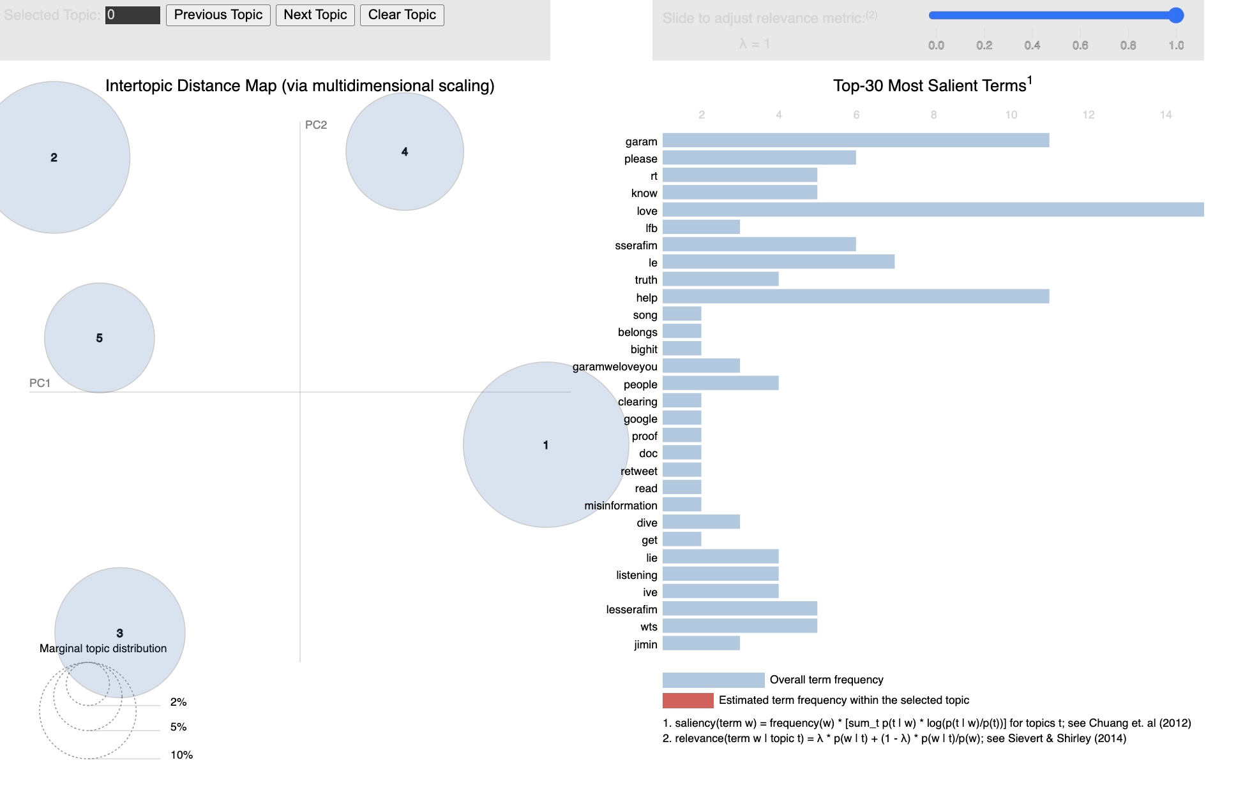
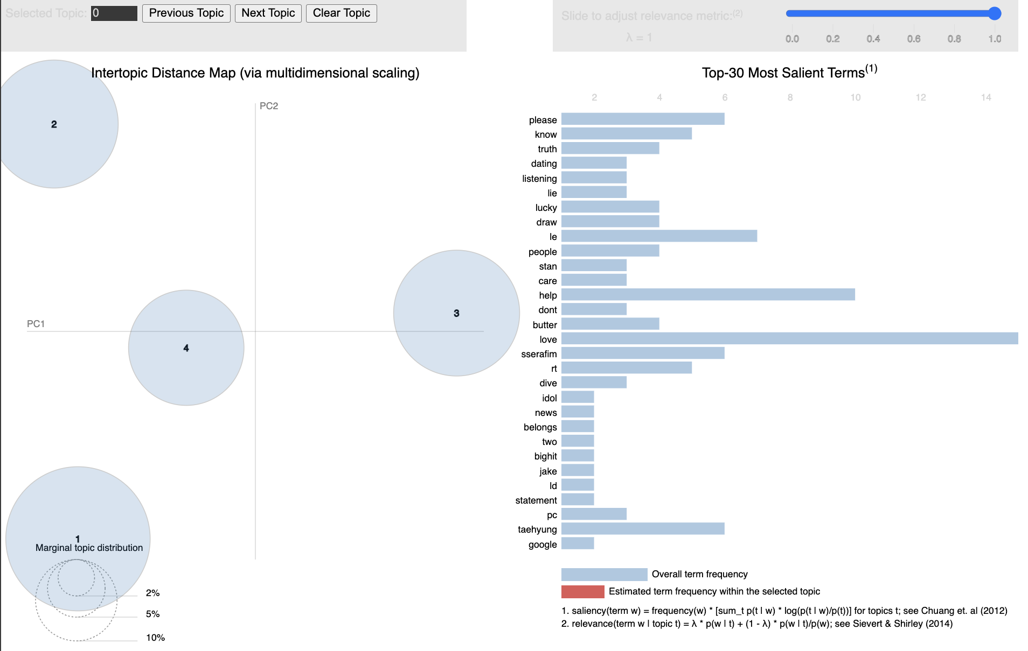
LDA(Latent Dirichlet Allocation)
N=5
N=4
Coherence Score: 0.4077119474287387
Coherence Score: 0.40067423796771384

Slide 13
Analysis of Keywords for understanding(LDA)
Case 1: When Topics = 5:
Topic 1: Community Engagement
Top Words : 'hybe', 'rt'("Retweet"), 'help', 'wts'(What to Sell), 'insight', 'lucky', 'draw', 'career', 'lfb'("Like for Buy”), 'also'
Likely Focus:
Discussions involving 'help', 'insight', 'career' suggest fans seeking or offering help and sharing insights about the industry.
Support indicators:
Informational Support: 'help', 'insight', 'career' (providing guidance or advice).
Emotional Support: Terms like 'lucky' might suggest positive sentiment, though it's not very strong in this context.
Topic 2: Controversies
Top Words : 'garam', 'love', 'can', 'dating', 'hybe', 'idol', 'time', 'kim', 'like', 'thing'
Likely Focus:
Focus on Garam and related issues, with mentions of 'dating' and 'idol' pointing to specific controversies.
Support indicators:
Emotional Support: 'love' suggests emotional support.
Appraisal Support: Discussions about 'idol', 'dating' could involve feedback or opinions.
Topic 3: General Sentiments
Top Words : 'please', 'love', 'garam', 'lesserafim'('I'm Fearless'), 'know', 'truth', 'lie', 'listening', 'hybe', 'le'(fandom name)
Likely Focus:
Emotional expressions such as 'please', 'love', 'know', 'truth', 'lie', 'listening' indicate general sentiments and emotional responses.
Support indicators:
Emotional Support: 'love', 'please', 'listening' suggest emotional engagement and support.
Appraisal Support: 'truth', 'lie' could involve validation or feedback.
Topic 4: Artist Promotions
Top Words : 'hybe', 'taehyung', 'help', 'love', 'stan', 'will', 'going', 'jungkook', 'butter', 'deluxe'
Likely Focus:
Terms like 'butter', 'deluxe' and mentions of specific artists (Taehyung, Jungkook) suggest discussions about songs, albums, and promotions.
Support indicators:
Informational Support: 'help' indicates guidance or assistance.
Emotional Support: 'love', 'stan' (which means being a dedicated fan) indicate emotional support and enthusiasm.
Topic 5: Fan Support
Top Words : 'love', 'hybe', 'garam', 'ive', 'sserafim', 'le', 'dive', 'care', 'now', 'people'
Likely Focus:
Terms like 'love', 'care', and mentions of various idols and groups suggest emotional and sometimes practical support for idols and groups.
Support indicators:
Emotional Support: 'love', 'care' suggests emotional support.
Instrumental Support: 'people', 'care' could imply practical assistance or help.

Slide 14
Case 2: When Topics = 4:
Analysis of Keywords for understanding(LdA)
Topic 0: Artist Promotions and Fan Support
Keywords: hybe, taehyung, lucky, draw, love, wts, butter, help, career, insight
Theme: This topic focuses on artist promotions and fan support activities, mentioning promotions related to "hybe" and artists like "taehyung". It includes fan support activities such as "lucky draw" events, expressions of love, and requests for help. There is also a focus on career insights.
Support Type: Instrumental and Emotional
Topic 1: General Sentiments and Emotional Support
Keywords: hybe, know, truth, love, dating, listening, lie, people, garam, care
Theme: This topic encompasses general sentiments and emotional support, discussing knowing the truth, expressions of love, issues around dating, and listening. It also includes mentions of "garam" and caring for people.
Support Type: Emotional and Appraisal
Topic 2: Controversies and Community Engagement
Keywords: please, help, le, sserafim, garam, lesserafim, rt, hybe, ive, dive
Theme: This topic covers controversies and community engagement, with a focus on asking for help, mentions of specific groups and individuals like "sserafim" and "garam", and fan activities such as retweeting. There are also mentions of "hybe" and activities related to the group "ive".
Support Type: Informational and Instrumental
Topic 3: Fan Loyalty and General Discussions
Keywords: love, hybe, stan, garam, can, also, career, kpop, kim, issue
Theme: This topic highlights fan loyalty and general discussions, with a strong focus on love and support for artists, mentions of "hybe", and fan stans. It also includes general discussions about career, K-pop, and issues surrounding individuals like "garam".
Support Type: Emotional and Appraisal

Slide 15
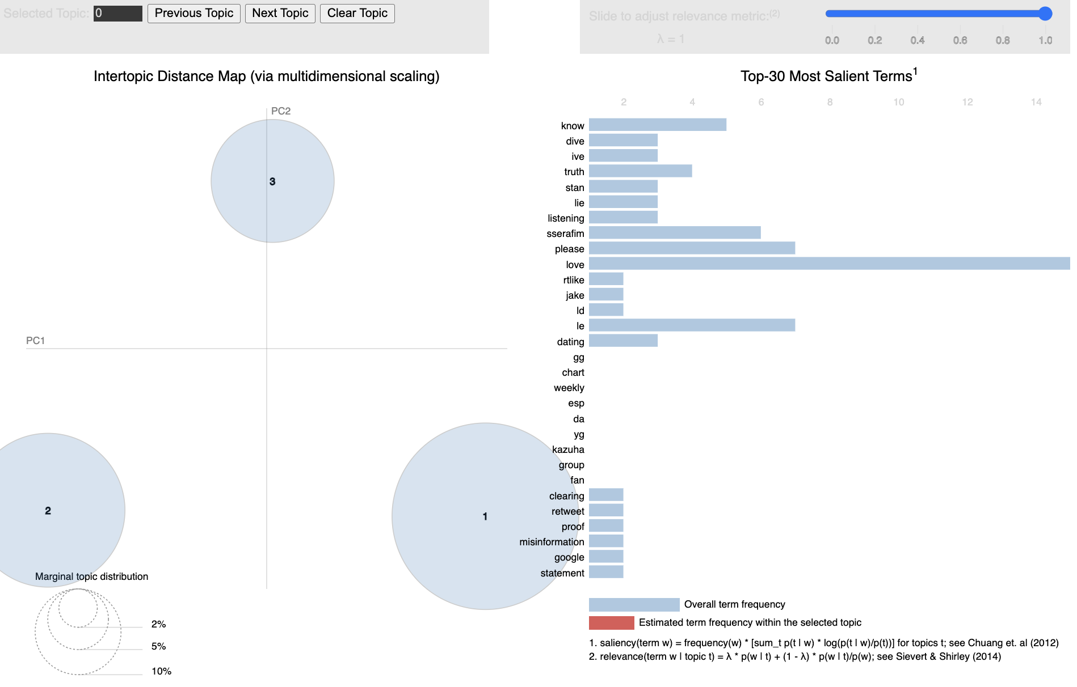
Results of Model Training
LDA
N=3
Code:
https://colab.research.google.com/drive/1kK5eH_qAHsSuRt9oGEMVvM3uDT83u_44?usp=sharing
Coherence Score: 0.4364425495026641

Slide 16
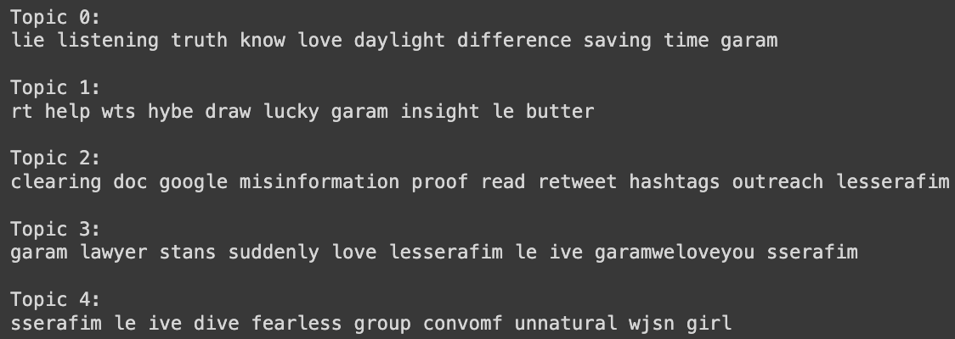
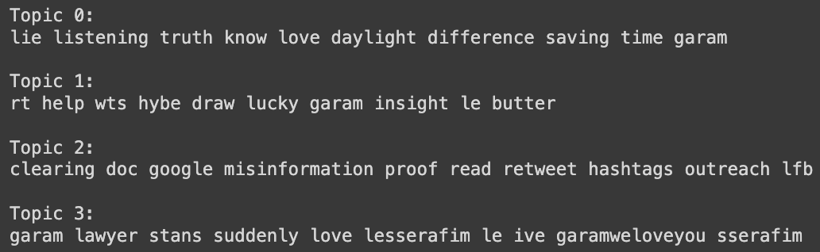
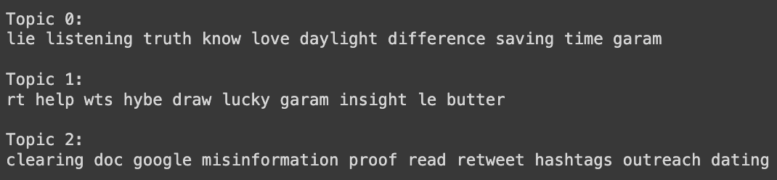
LSA
N=5
N=4
Top Words
Top Words
Coherence Score: 0.6001629719948143
Coherence Score: 0.5782839575215982
N=3
Top Words
Coherence Score: 0.710182273988263

Slide 17
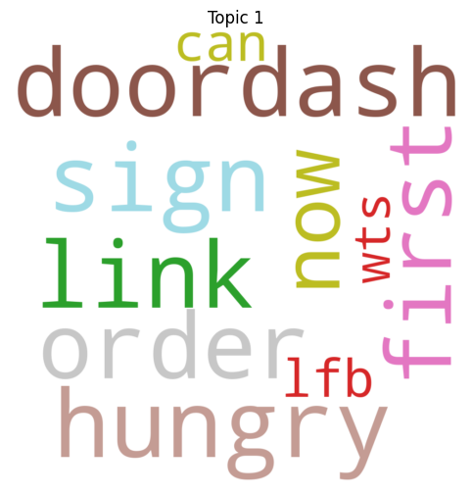
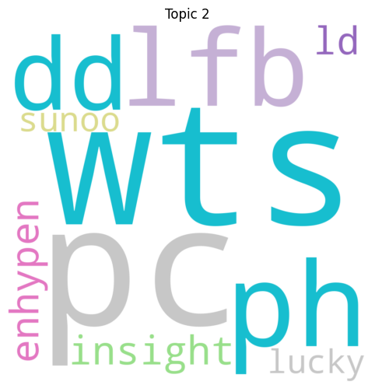
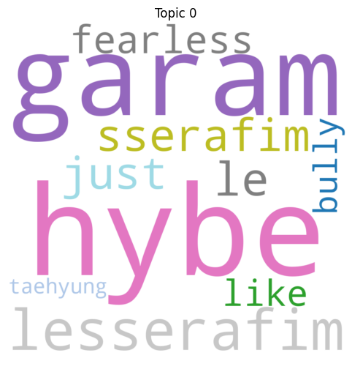
BERTopic
https://colab.research.google.com/drive/1PyRQB1Lht9btkqVYjyPOrbaHvToysS_f?usp=sharing

Slide 18
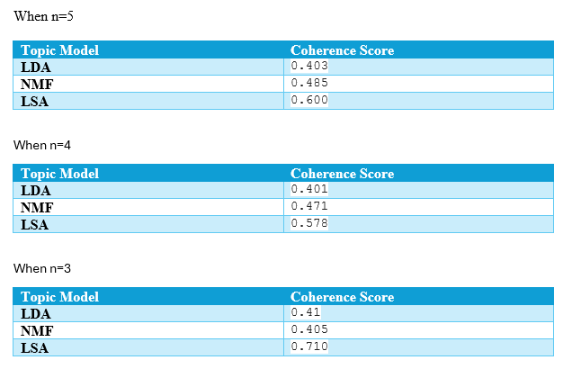
Results
When n=5
When n=4
When n=3
When n=5:
Topic Model | Coherence Score
LDA | 0.403
NMF | 0.485
LSA | 0.600
When n=4
Topic Model | Coherence Score
LDA | 0.401
NMF | 0.471
LSA | 0.578
When n=3
Topic Model | Coherence Score
LDA | 0.41
NMF | 0.405
LSA | 0.710

Slide 19

THANK YOU

